Slide 1
Housing: Price prediction
By Miral Dhrafani

Slide 2
Introduction
Real estate is the world biggest industry. One of the biggest concern in investing in the real estate industry is to study the structure and dynamics of the residential or commercial space. The price of the property depends on various factor such location, space, neighbourhood, proximity to school/transportation etc and also Due to constant fluctuation in demand and supply it is very difficult to identify the real worth of a property. To address this issue, data science comes as a very important tool to solve problem by predicting the accurate price of the property by analyzing various features and comparing it with the label. Predict the selling price with the help of historical datar customer satisfaction.

Slide 3
Introduction (Contd)
Houses are one of the necessary need of each and every person around the globe and therefore housing and real estate market is one of the markets which is one of the major contributors in the world’s economy. It is a very large market and there are various companies working in the domain. Data science comes as a very important tool to solve problems in the domain to help the companies increase their overall revenue, profits, improving their marketing strategies and focusing on changing trends in house sales and purchases. Predictive modelling, Market mix modelling, recommendation systems are some of the machine learning techniques used for achieving the business goals for housing companies. Our problem is related to one such housing company. A US-based housing company named Surprise Housing has decided to enter the Australian market. The company uses data analytics to purchase houses at a price below their actual values and flip them at a higher price. For the same purpose, the company has collected a data set from the sale of houses in Australia. The data is provided in the CSV file below. The company is looking at prospective properties to buy houses to enter the market. You are required to build a model using Machine Learning in order to predict the actual value of the prospective properties and decide whether to invest in them or not. For this company wants to know:
Which variables are important to predict the price of variable?
How do these variables describe the price of the house?

Slide 4
Analytical Problem Framing
Data Source and format
data provided by Flip Robo Technologies
Two CSV files - one Train data and second Test Data
shape of the data -
Training Data - 1168 Rows and 81 columns
Test Data - 1168 Rows and 80 columns
some of the important features of data:
Exterior - exterior quality, Condition, exterior material
Roofing material, Ground Living Area, Neighbourhood
Year Built, Air conditioning

Slide 5
Analytical Problem Framing (contd)
Data Preprocessing
Two data-set was provided training and test data-set, training data-set contains 81 columns which includes 80 features and 1 label columns, test data contains 80 columns all of them are features data and we need to predict label based on the model we build. Data provided was bit noisy there were lots of null values, we treated null values based on the observation we made. There we around 35 object columns so we encoded those columns. We also removed the skewness and outliers from the continuous columns
Hardware and software requirement and tools used
A PC with pre-install Anaconda Navigator has been used, Jupiter Notebook was used as a platform to run Python, different python libraries were used such as pandas for data manipulation, numpy for calculations and sea-born and matplotlib for visualization

Slide 6
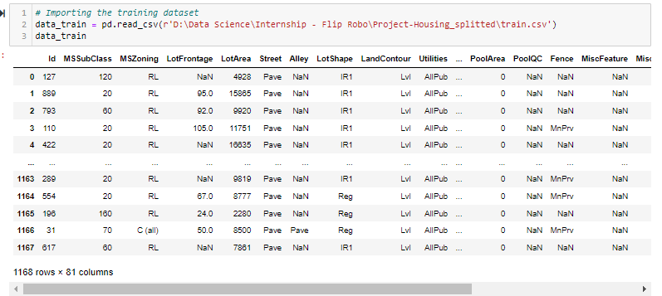
Understating the Data
Two Dataset - Training and test
Structure - 80 Features and 1 label
Feature data consists of categorical and contineous column
Label Data - Selling Price (Countineous Data)
Data has null values, Skewed data and outliers

Slide 7
Analysis and visualization
Using pandas, Seaborn and Matplotlib

Slide 8
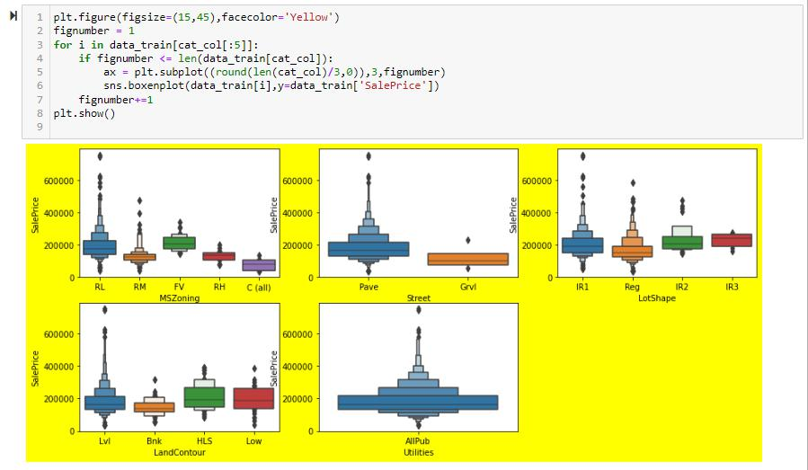
Distribution of Categorical Data
Zoning - we can see that floating house are the most expensive houses with avergar sale price of 209479 and commercial properties are the cheapest with average selling price of 75209 dollars
properties on the paved road are more expensive than gravel road
sales price of the house are inversely proportionate to its shape, the more irregular shape, more expensive houses are
Hillside and low depression houses are more expensive as compared to near flat and banked houses
there is only single variable on utilities column, so there is no point in keeping this column so we will delete this column

Slide 9
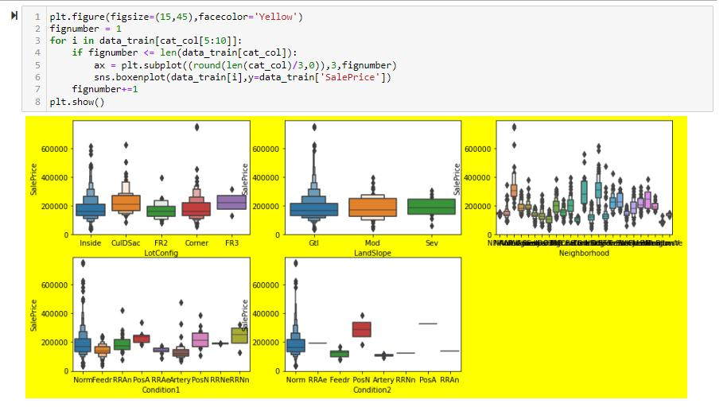
Distribution of Categorical Data
•
there is no significant impact of land configure and land slope in the sale price of the property
properties near railroad and feature park are more expensive as compared to other areas

Slide 10
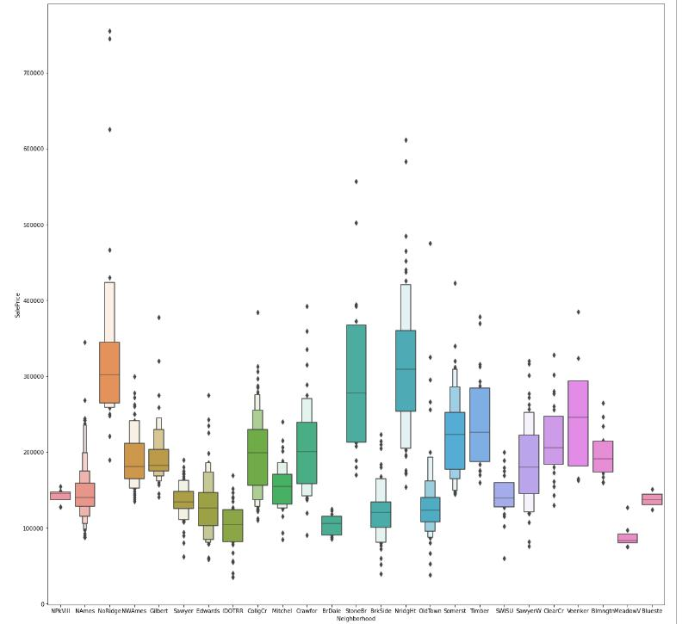
Neighbourhood
•
localities like Northridge Heights, Stone Brook, Northridge have highest selling prices, whereas localities like Meadow Village, Bluestem and Briardale are some of the cheapest locality

Slide 11
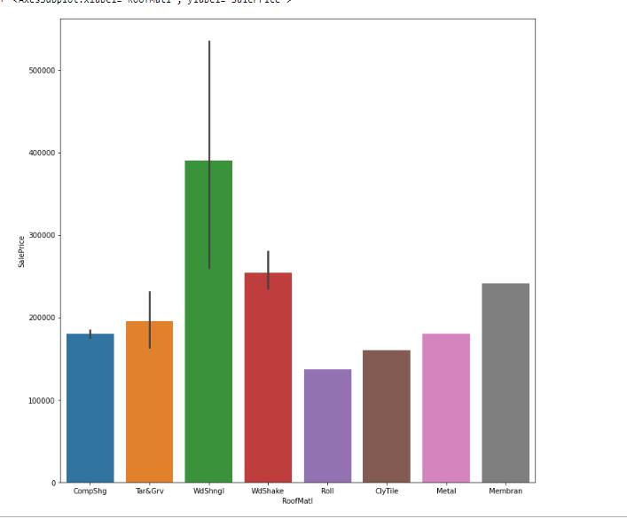
Roofing Material
Selling price for property is higher when wood is used as the primary material for roof, on the other hand when roll,clay or tiles are used, the selling price are tends to be less

Slide 12
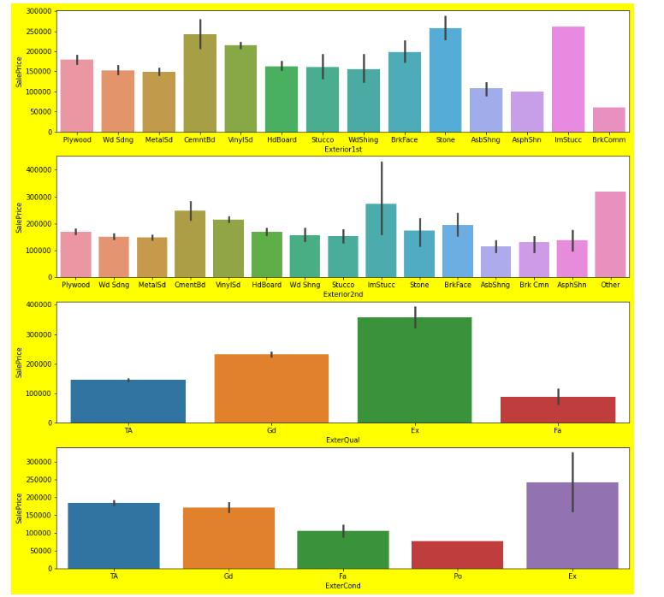
Exterior
if sturdy material such as stone, cement, vinyl and brick face are used for exterior the selling price tends to up
exterior condition and quality are directly proportionate to the selling price, if the exterior condition is excellent, the selling price of those properties are highest, however if the condition or quality goes down the selling price

Slide 13
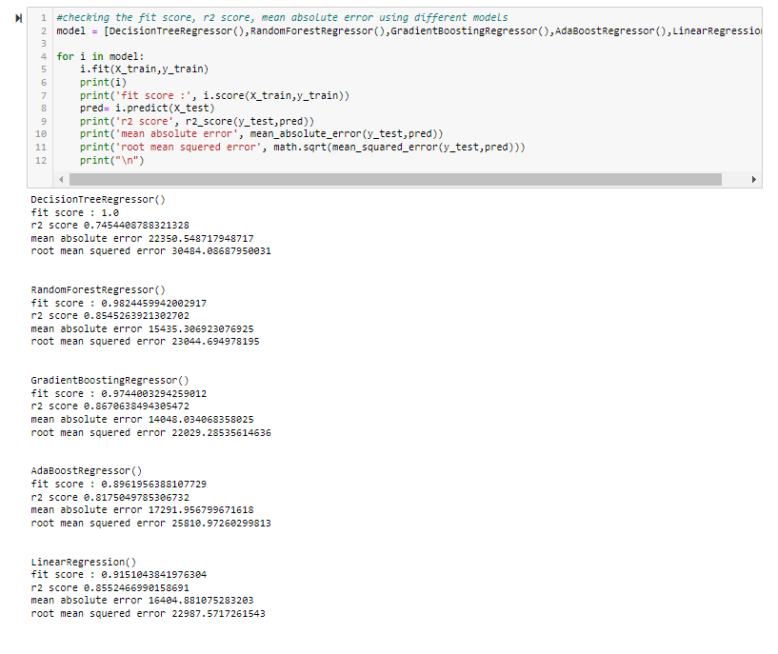
Training the model
5 model has been used for training the model
Random Forest Regressor
Gradient Boost Regressor
Decision Tree Regressor
AdaBoost Regressor
Linear Regression
Gradient Boost Regressor is the best performing model with fit score of .97 and r2 score of .87

Slide 14
Conclusion
Many factor such as exterior quality, Neighborhood, ground living area plays a major role in determining the prices, also the age of property is also considered by the buyer before buying any property, as people usually prefer newer property over older property . also air conditioning property are likely to sell at higher prices, So to conclude we can conclude that not only material or land area determines the price but also the features provided like Air conditioning is also very important factor in evaluating the price of the property

